Slide 1
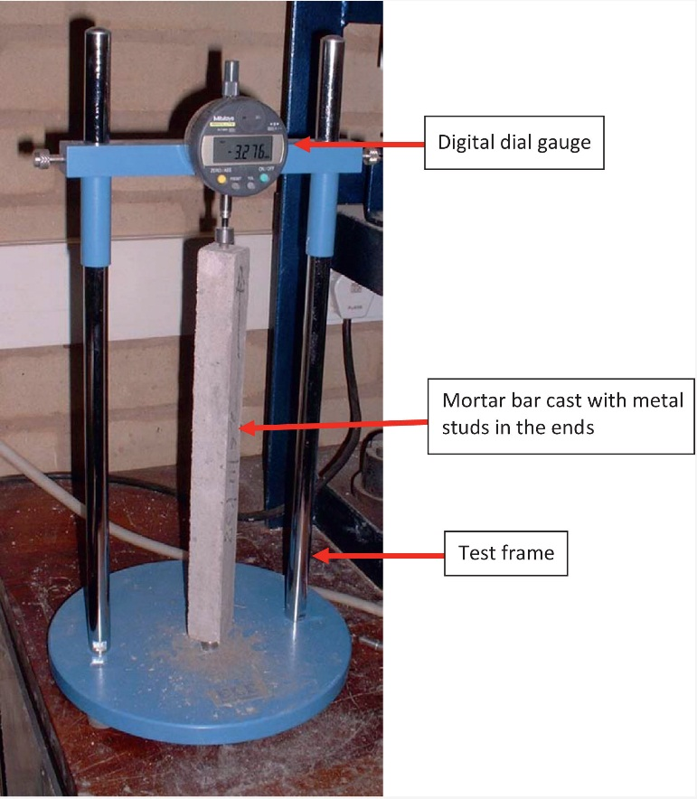
FIGURE 19.1 Mortar Bar Expansion Test

Slide 2
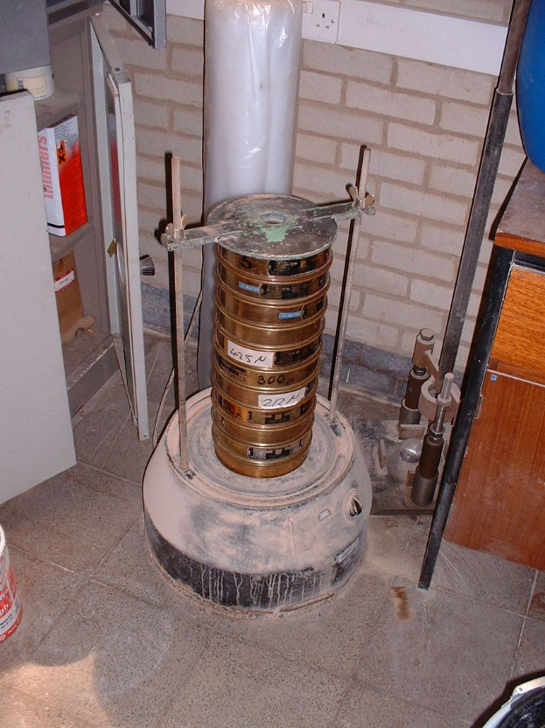
FIGURE 19.2 Sieves Stacked in Sieve Shaker

Slide 3
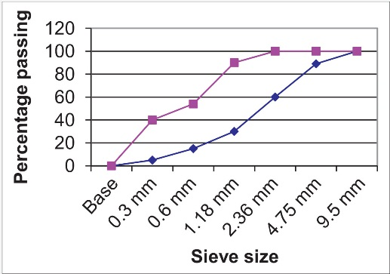
FIGURE 19.3 Fine Aggregate Coarse Grading Limits

Slide 4
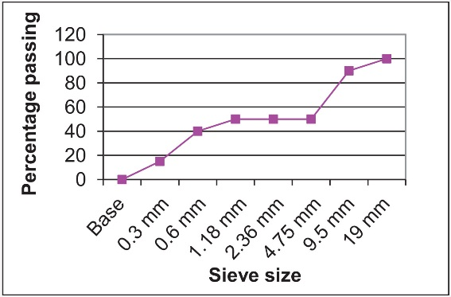
FIGURE 19.4 Gap Graded Aggregate

Slide 5
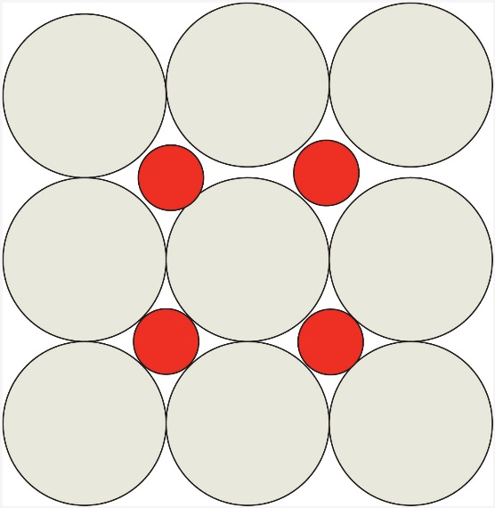
FIGURE 19.5 Schematic Representation of Packing with Gap-Graded Aggregate

Slide 6
